Slide 1
2022
CSYE 7200
Game Recommendation System
---------- Group 2 -----------
Chen Ye - 002951477
Xinzhuo Liu - 002197134
Jingru Xiang - 001586653
➡️

Slide 2
Catalog
01
05
02
Introduction
06
Goals of Project
03
05
User cases
04
Acceptance Criteria
Mile Stones
Methodology
Data Source

Slide 3

Introduction
Game Recommendation System
The gaming industry has been booming in recent years, with all types of games popping up.
The variety of games in the gaming market is dizzying.
Therefore, when users land on the game market, it is particularly important to invest in their favorite recommendation system.

Slide 4
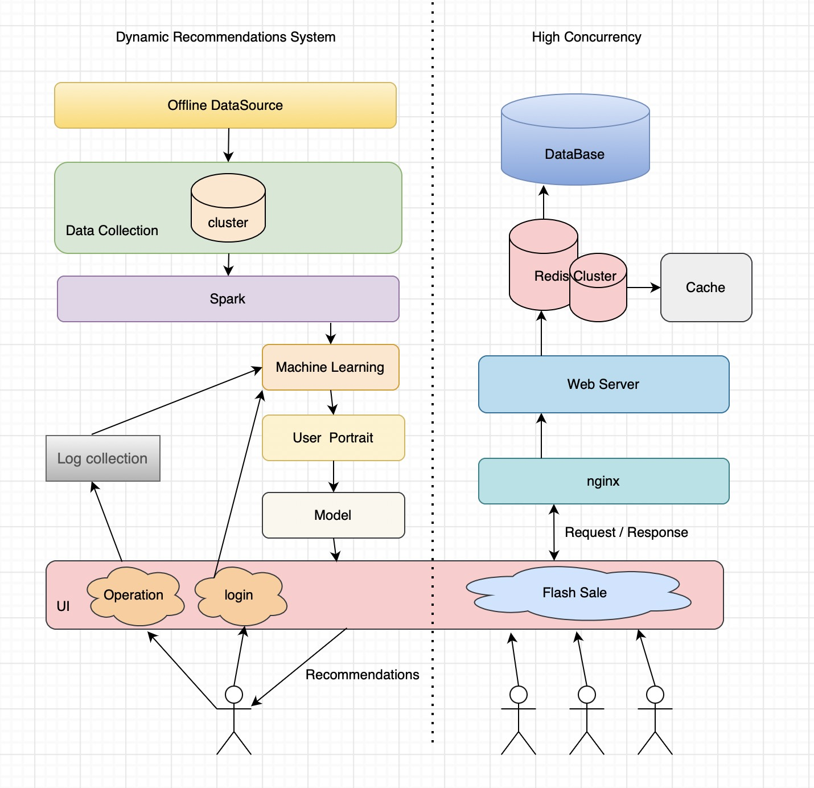
User cases
Main：
- User registration, enter basic information (ID, Favorite Games).
- Put the basic information into the trained model to generate the initial recommendation page
- Users browse the game list, search for game keywords (name or tag), update user profiles, and refresh recommendation information
Optional：
- Launched a limited time discount game, set the time and limited quantity.
- The user places an order at a specified time.

Slide 5

Methodology
- Main: Java Swing + Scala + Spark + Play Framework
- Option:
Akka gRPC & Kafka for transport mechanisms
Event Sourcing for event persistence after a user updates her/his cart
Command Query Responsibility Segregation (CQRS for separating read and write responsibility
Akka projections for providing the data necessary for the Order and Analytics services

Slide 6

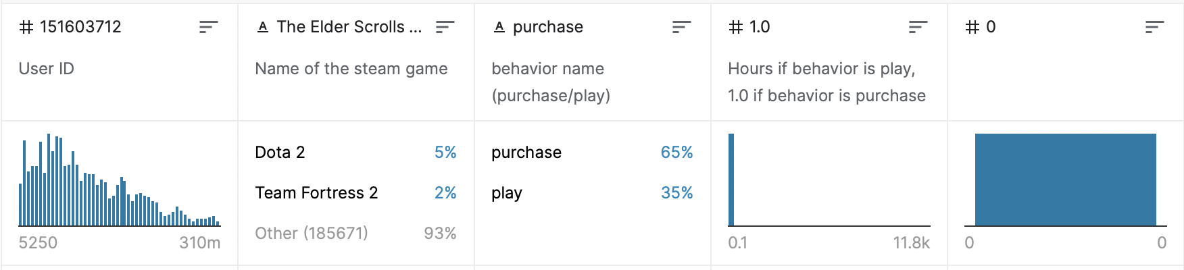
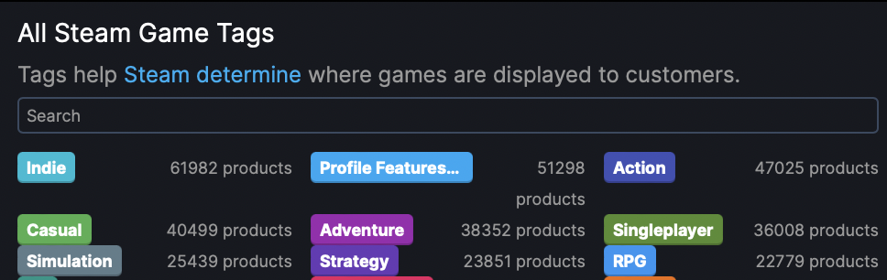
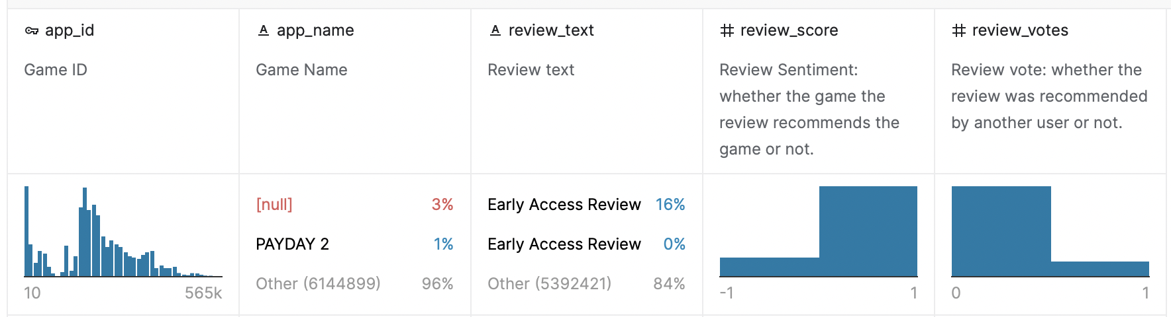
Data Sourse
User portrait database (The amount of data: 200k)
https://www.kaggle.com/code/danieloehm/steam-game-recommendations/data
steam tag database
https://steamdb.info/tags/
Evaluate database (The amount of data: 6417.1k)
https://www.kaggle.com/code/dardodel/steam-reviews-auto-topic-modeling-w-transformers/data

Slide 7
Mile Stones
Mar. 27th – Apr. 2nd
Apr. 3rd – Apr. 9th
Apr.10th – Apr.16th
Apr.17th – Apr.23rd
Apr.24th – Apr. 28th
Collect Data
Build Environment
Design UI and UX
Finish Functions
Presentation
Collect data from Kaggle, decide complete logic, and technology we need, prepare for planning presentation(All)
Build environment, import the jar package, establish the basic framework for our project(Xinzhuo Liu), and data cleaning and preprocessing(Chen Ye). Simulate a large number of concurrent users(Jingru Xiang).
Design UI and UX elements using Java Swing(Chen Ye), meanwhile, finish initial ML train and test(Jingru Xiang). Then, add codes for part of reactive component.(Xinzhuo Liu, Jingru Xiang)
Backend using Scala to finish functions to write interaction data(Jingru Xiang) and real time update recommendation(Xinzhuo Liu). Finish unit test(Chen Ye).
PowerPoint and prepare for presentation(All)

Slide 8

Acceptance criteria
Content
The average correlation between the game and the user‘s preference on the recommended user page is more than 70% (Choosing 30% of data in the dataset as test data. For the test data, each recommended game matches the previous one in the database can be counted as 1, and the mean of the game's recommended readiness rate is calculated)
Rate all games. The mean score of recommended games on the whole page should exceed 0.5 (recommended by 50% players)
Users
1. The user gets the results of the initial login referral page for less than 1s
2. The user gets an update page refresh for no more than 1s
System
1. The user's initial data is selected and stored by the database(Distinct user in 30% data in user portrait database)
2. User search tags are logged in the MongoDB database
Optional
Specify acceptance criteria by simulating the high concurrency of a user placing a large number of orders in the same time period. TP99 should be controlled within 200 milliseconds and the response time should not exceed one second

Slide 9
Goals of the project
Through the training set, design a suitable data model. Collect the user's basic information, catch the operation actions, constantly update the user profile to achieve the most suitable recommended content, and verify the recommended content matching degree through (some indicator).
Evaluate the system's high concurrency performance by simulating spikes and obtaining system performance metrics (average response time, throughput).
At 10,000 requests per second, AVG is controlled below 50ms and TP99 is controlled below 100ms.
MAIN
OPTION
The Goals

Slide 10
2022
CSYE 7200
Thank you for watching
END

